Slide 1

A Comparison between Global and Multiple Testing Procedures
Supervisors:
Dr Abigail Burdon, Dr Dominique-Laurent Couturier
Presenter:
Hongda Yuan

Slide 2

Introduction
Background: Clinical trials with several outcomes (endpoints);
Motivation: Improve clinical trial efficiency and reduce trial costs;
(Equivalently,) use statistical tests with high power.

Slide 3
Introduction – Motivating Example
A clinical trial for cardiovascular disease (Kim et al.[2020])
2 arms
Control: Standard of care
Treatment: Standard of care + An additional treatment
2 endpoints
Blood pressure (BP)
Cholesterol level (LDL)
2 testing procedures
Intersection Test: Endpoints have synergistic effects, both endpoints significant.
Union Test: At least one endpoint is significant.

Slide 4
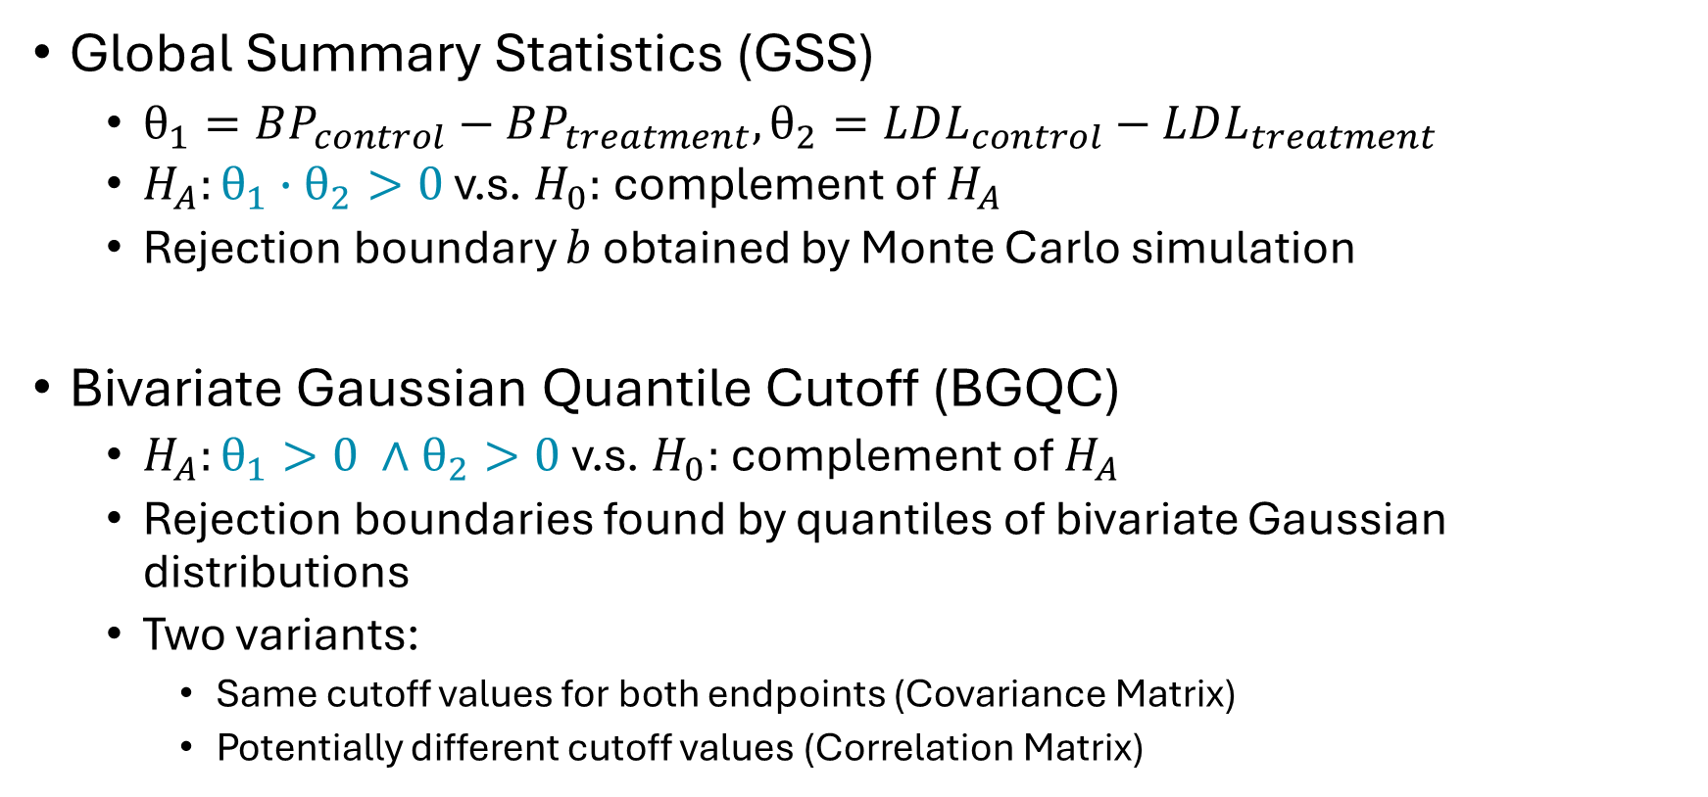
Intersection Testing Procedure
Global Summary Statistics (GSS)
$θ_{1}=BP_{control}−BP_{treatment},θ_{2}=LDL_{control}−LDL_{treatment}$
$H_{A}:θ_{1}∙θ_{2}>0$ v.s. $H_{0}:$complement of $H_{A}$
Rejection boundary $b$ obtained by Monte Carlo simulation
Bivariate Gaussian Quantile Cutoff (BGQC)
$H_{A}:θ_{1}>0 ∧θ_{2}>0$ v.s. $H_{0}:$complement of $H_{A}$
Rejection boundaries found by quantiles of bivariate Gaussian distributions
Two variants:
Same cutoff values for both endpoints (Covariance Matrix)
Potentially different cutoff values (Correlation Matrix)

Slide 5
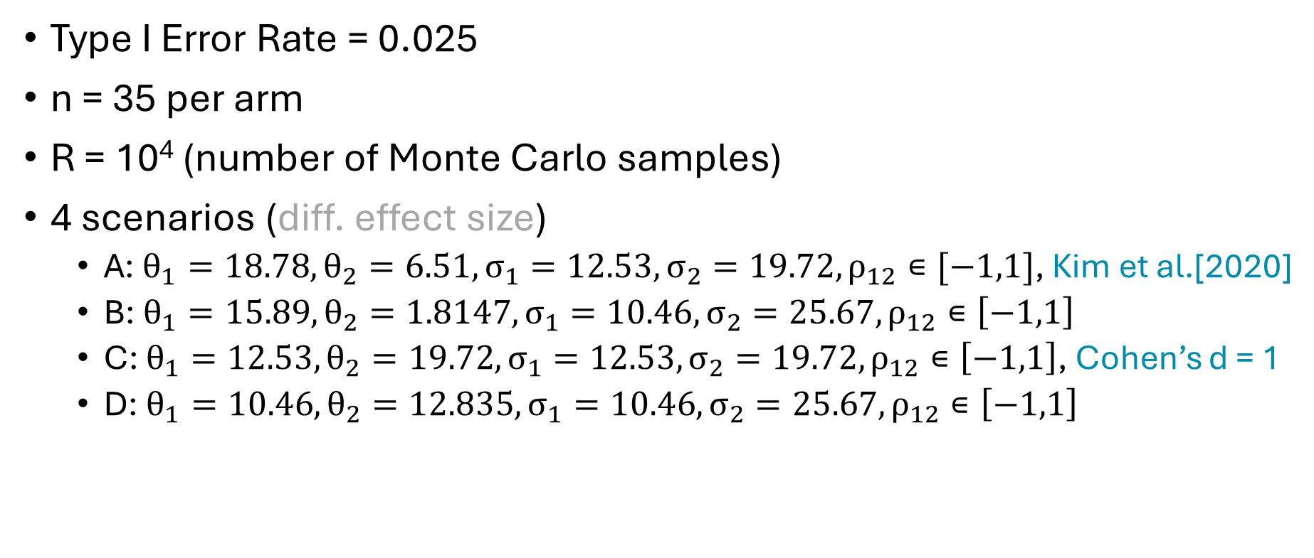
Simulation Setting
Type I Error Rate = 0.025
n = 35 per arm
R = 10⁴ (number of Monte Carlo samples)
4 scenarios (diff. effect size)
A: $θ_{1}=18.78,θ_{2}=6.51,σ_{1}=12.53,σ_{2}=19.72,ρ_{12}∊[−1,1]$, Kim et al.[2020]
B: $θ_{1}=15.89,θ_{2}=1.8147,σ_{1}=10.46,σ_{2}=25.67,ρ_{12}∊\left[−1,1\right]$
C: $θ_{1}=12.53,θ_{2}=19.72,σ_{1}=12.53,σ_{2}=19.72,ρ_{12}∊\left[−1,1\right]$, Cohen’s d = 1
D: $θ_{1}=10.46,θ_{2}=12.835,σ_{1}=10.46,σ_{2}=25.67,ρ_{12}∊\left[−1,1\right]$

Slide 6
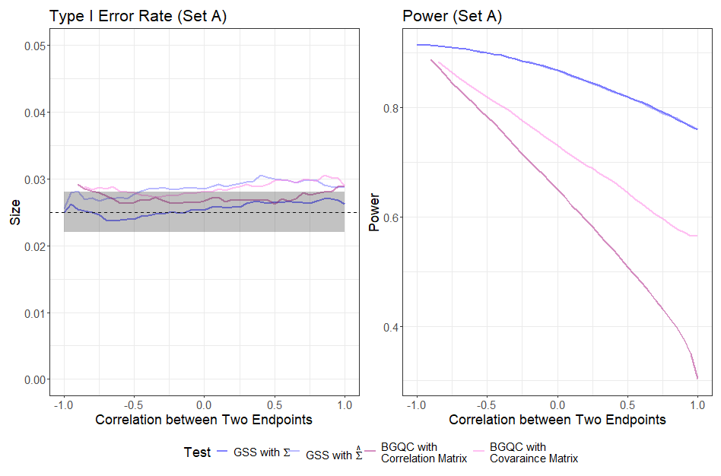
Results - Under Intersection Error Rate (Set A)

Slide 7
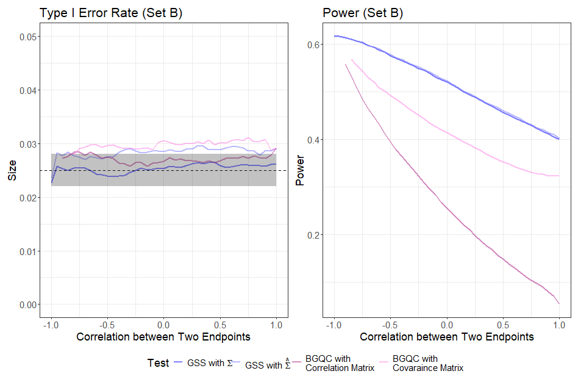
Results - Under Intersection Error Rate (Set B)

Slide 8
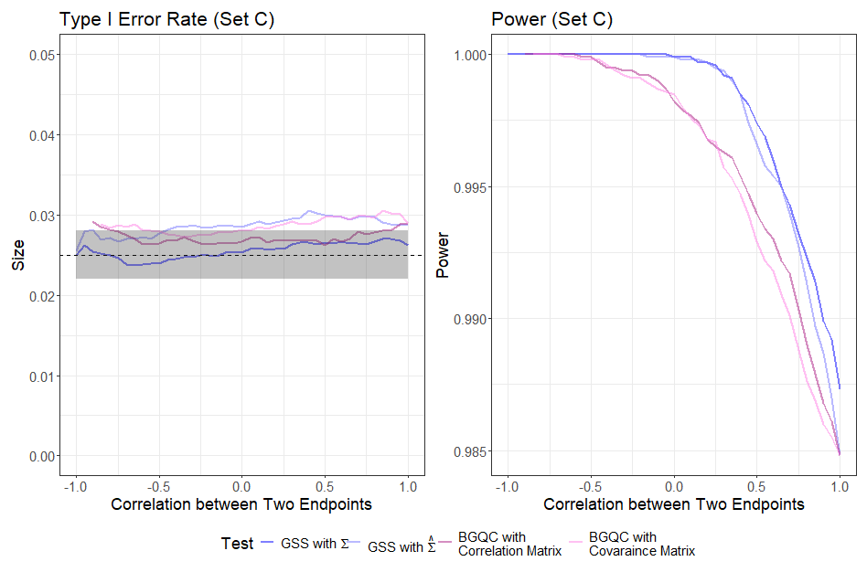
Results - Under Intersection Error Rate (Set C)

Slide 9
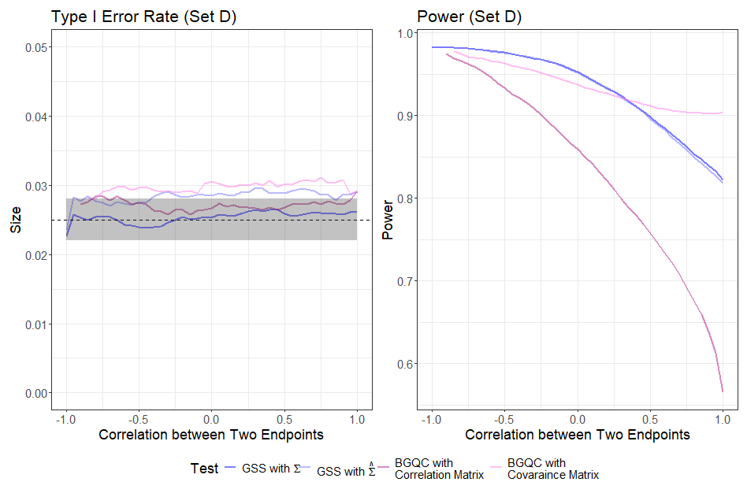
Results - Under Intersection Error Rate (Set D)

Slide 10
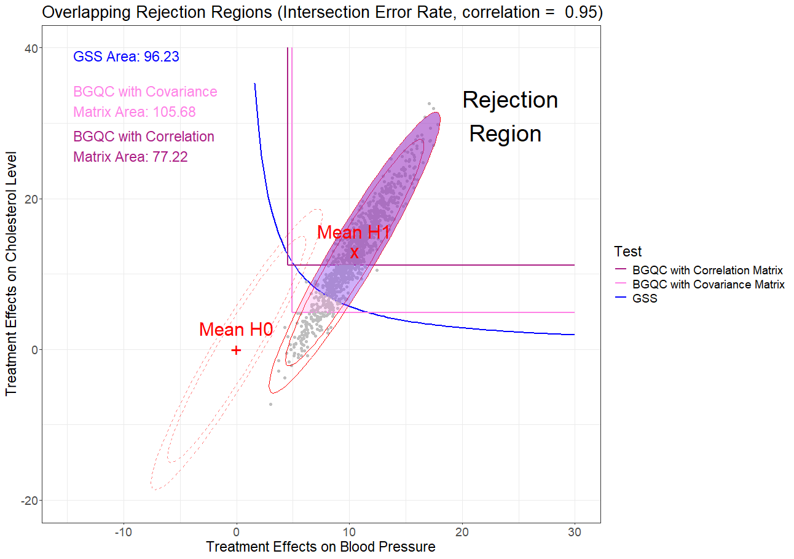
Results – Explanation (Set D)

Slide 11
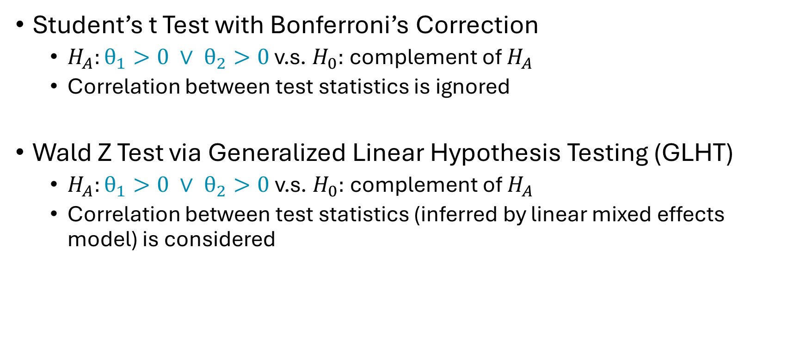
Union Testing Procedure
Student’s t Test with Bonferroni’s Correction
$H_{A}:θ_{1}>0 ∨ θ_{2}>0$ v.s. $H_{0}:$complement of $H_{A}$
Correlation between test statistics is ignored
Wald Z Test via Generalized Linear Hypothesis Testing (GLHT)
$H_{A}:θ_{1}>0 ∨ θ_{2}>0$v.s. $H_{0}:$complement of $H_{A}$
Correlation between test statistics (inferred by linear mixed effects model) is considered

Slide 12
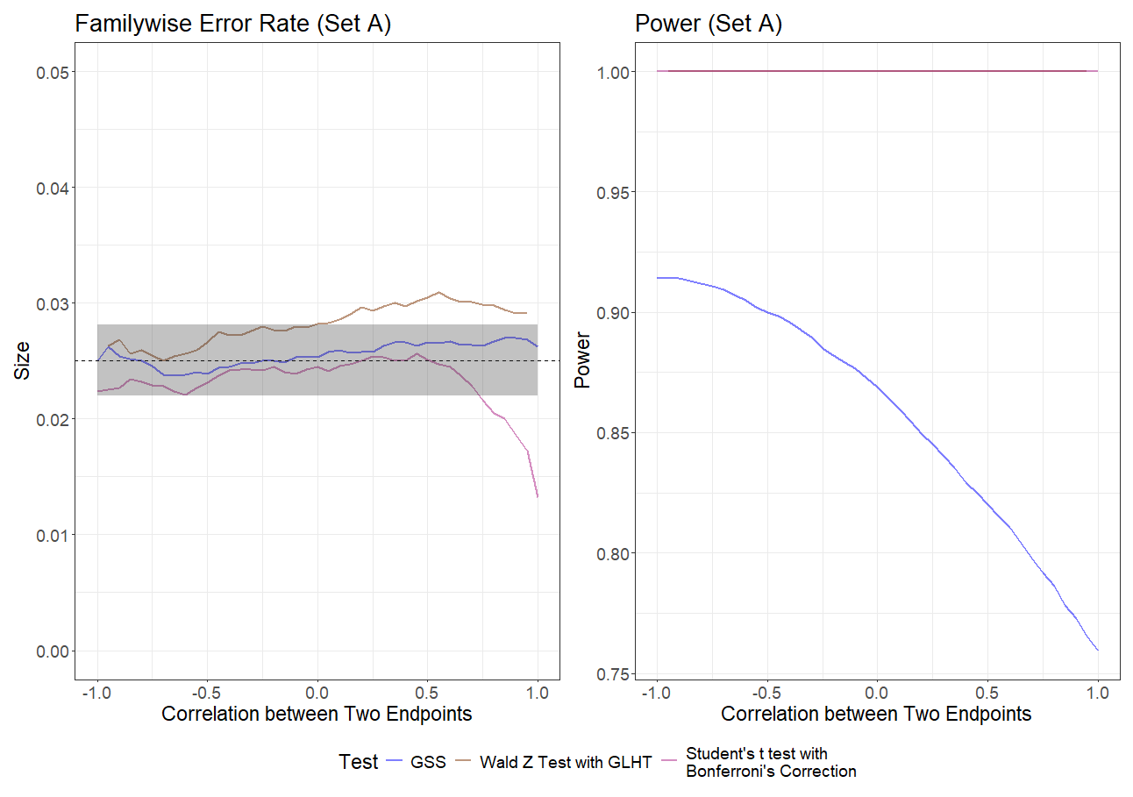
Results - Under Union Error Rate (Set A)

Slide 13
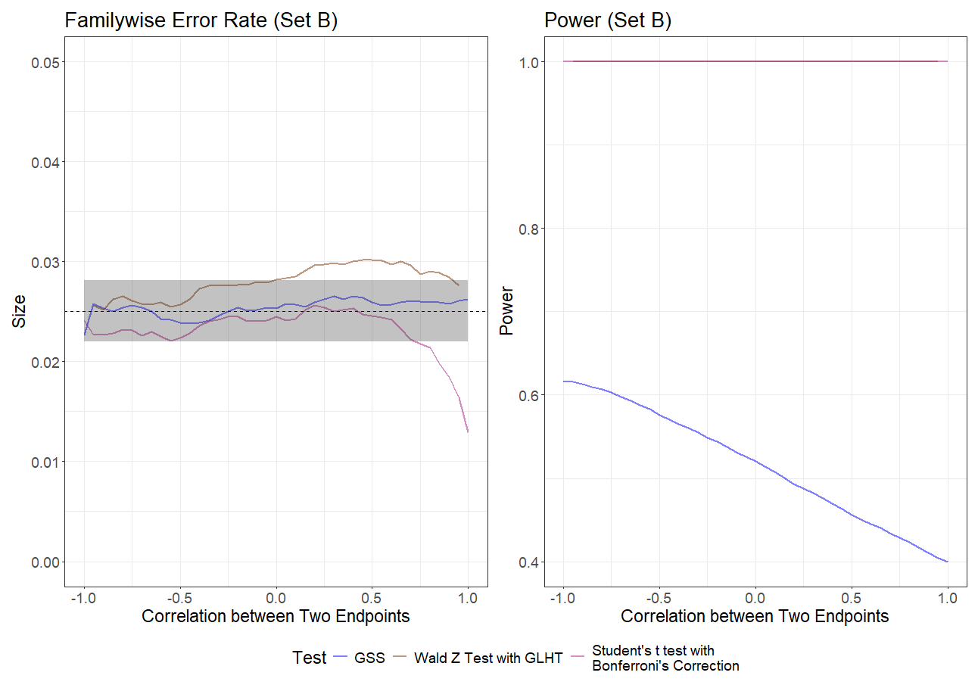
Results - Under Union Error Rate (Set B)

Slide 14
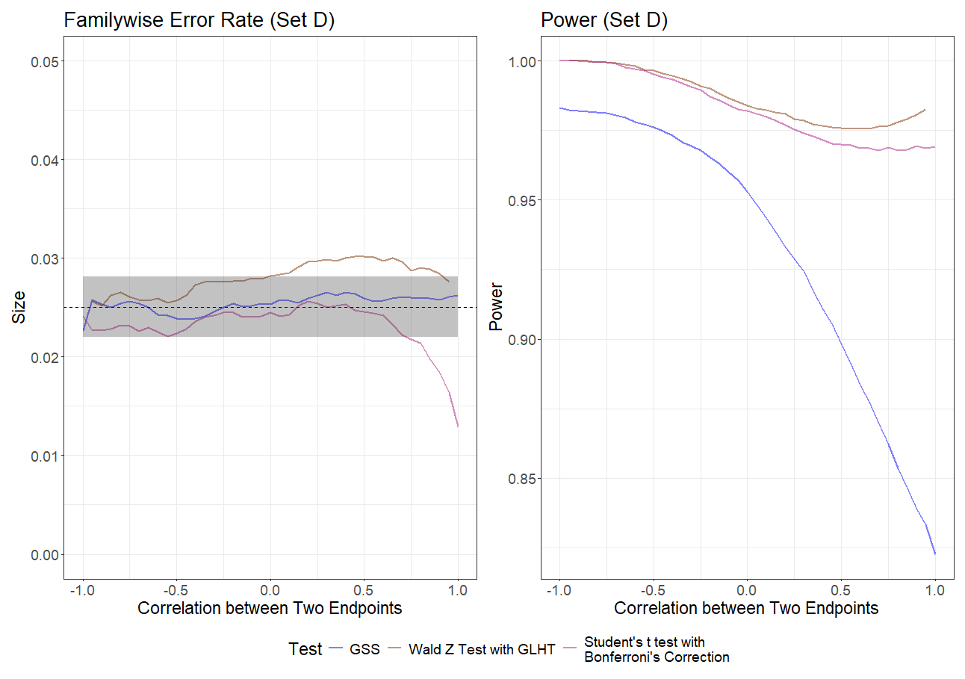
Results - Under Union Error Rate (Set D)

Slide 15
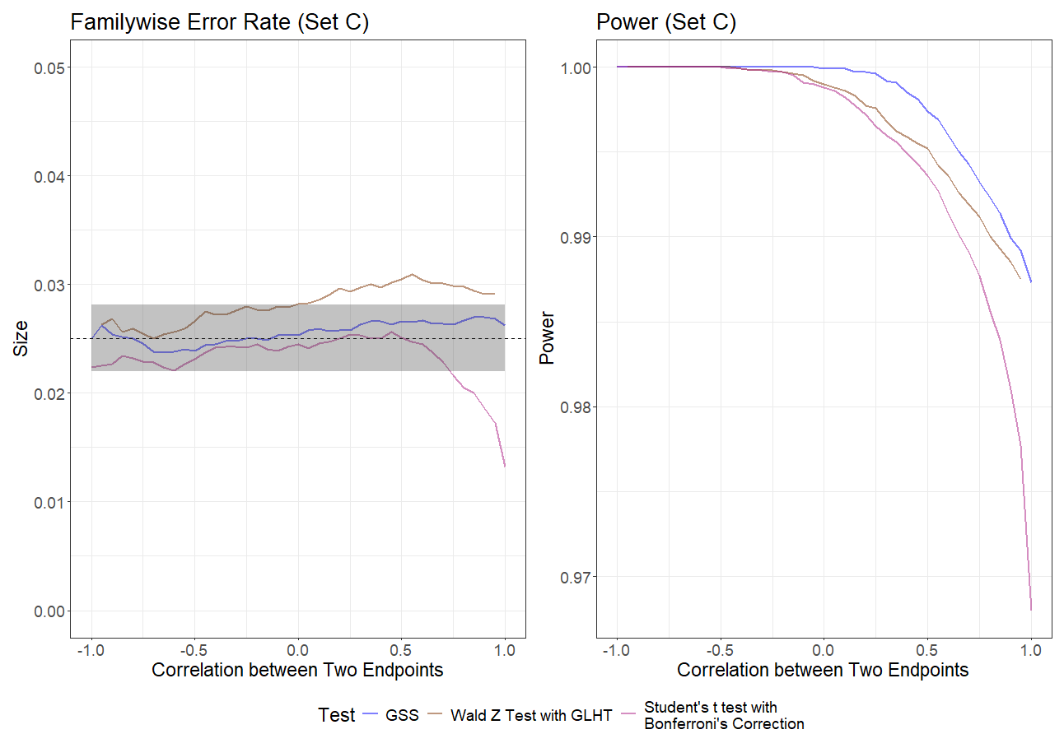
Results - Under Union Error Rate (Set C)

Slide 16
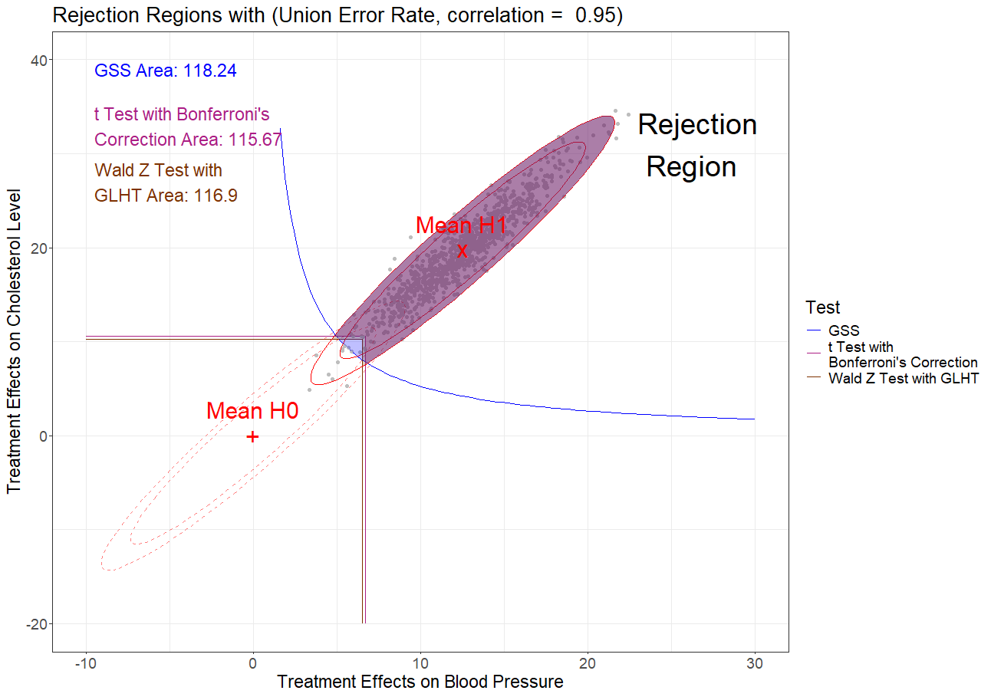
Results – Explanation (Set C)

Slide 17
Summary
Intersection Test: GSS has the highest power due to its shape of the rejection boundary
Union Test: GLHT has the highest power due to the consideration of correlation between two endpoints
Inflated Type I error rate/ familywise error rate due to small sample size when estimating the covariance matrix

Slide 18

Thank you! Reference Kim W, Chang K, Cho EJ, Ahn JC, Yu CW, Cho KI, Kim YJ, Kang DH, Kim SY, Lee SH, Kim U, Kim SJ, Ahn YK, Lee CH, Shin JH, Kim M, Park CG. A randomized, double-blind clinical trial to evaluate the efficacy and safety of a fixed-dose combination of amlodipine/rosuvastatin in patients with dyslipidemia and hypertension. J Clin Hypertens (Greenwich). 2020 Feb;22(2):261-269. doi: 10.1111/jch.13774. Epub 2020 Jan 31. PMID: 32003938; PMCID: PMC8029832.

